Slide 1

G-10 Concert Lounge
Alex Wilkinson
Hunter Steffner
Joseph Gossett
Matthew Lyjak

Slide 2
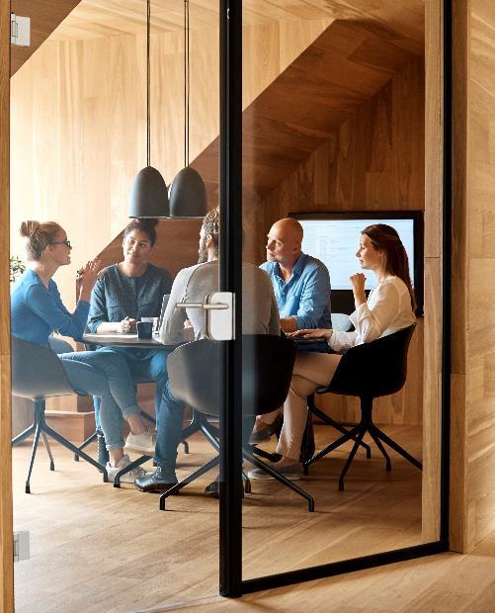



Introduction
G-10’s Concert Lounge allows users to search for a band’s concert within a selected State. It will display a map of the address of the concert along with a link to buy tickets. The site also allows the user to search for general information about the band.

Slide 3



Topics
Why use Concert Lounge?
Technologies Used
Challenges and Successes
Tasks and Roles
User Case Scenario
Future Additions

Slide 4

An easy way to search for band information and concert locations
The only things you need to know:
- Band Name
- State
Concert Lounge tells you all the rest!

Slide 5

Technologies Used
Challenges and Successes
Merge Conflicts!!!
Collaboration and Teamwork
Trying to do too much
Focusing on MVP first
Local Storage
Navigating the objects from Ticketmaster
Using cleaner Jquery methods
Adjusting layouts to match Wireframe
Being flexible with our collective ideas
HTML
CSS
Bootstrap
JQuery
Javascript
APIs
Google Maps
Ticketmaster
Leaflet
Github

Slide 6
Tasks and Roles
 | Planning/Logistics | Design | Styling | Development
Wilkinson | Senior | Senior | Lead | Junior
H. Steffner | Senior | Junior | Junior | Lead
J. Gossett | Senior | Lead | Senior | Junior
M. Lyjak | Lead | Junior | Junior | Senior

Slide 7
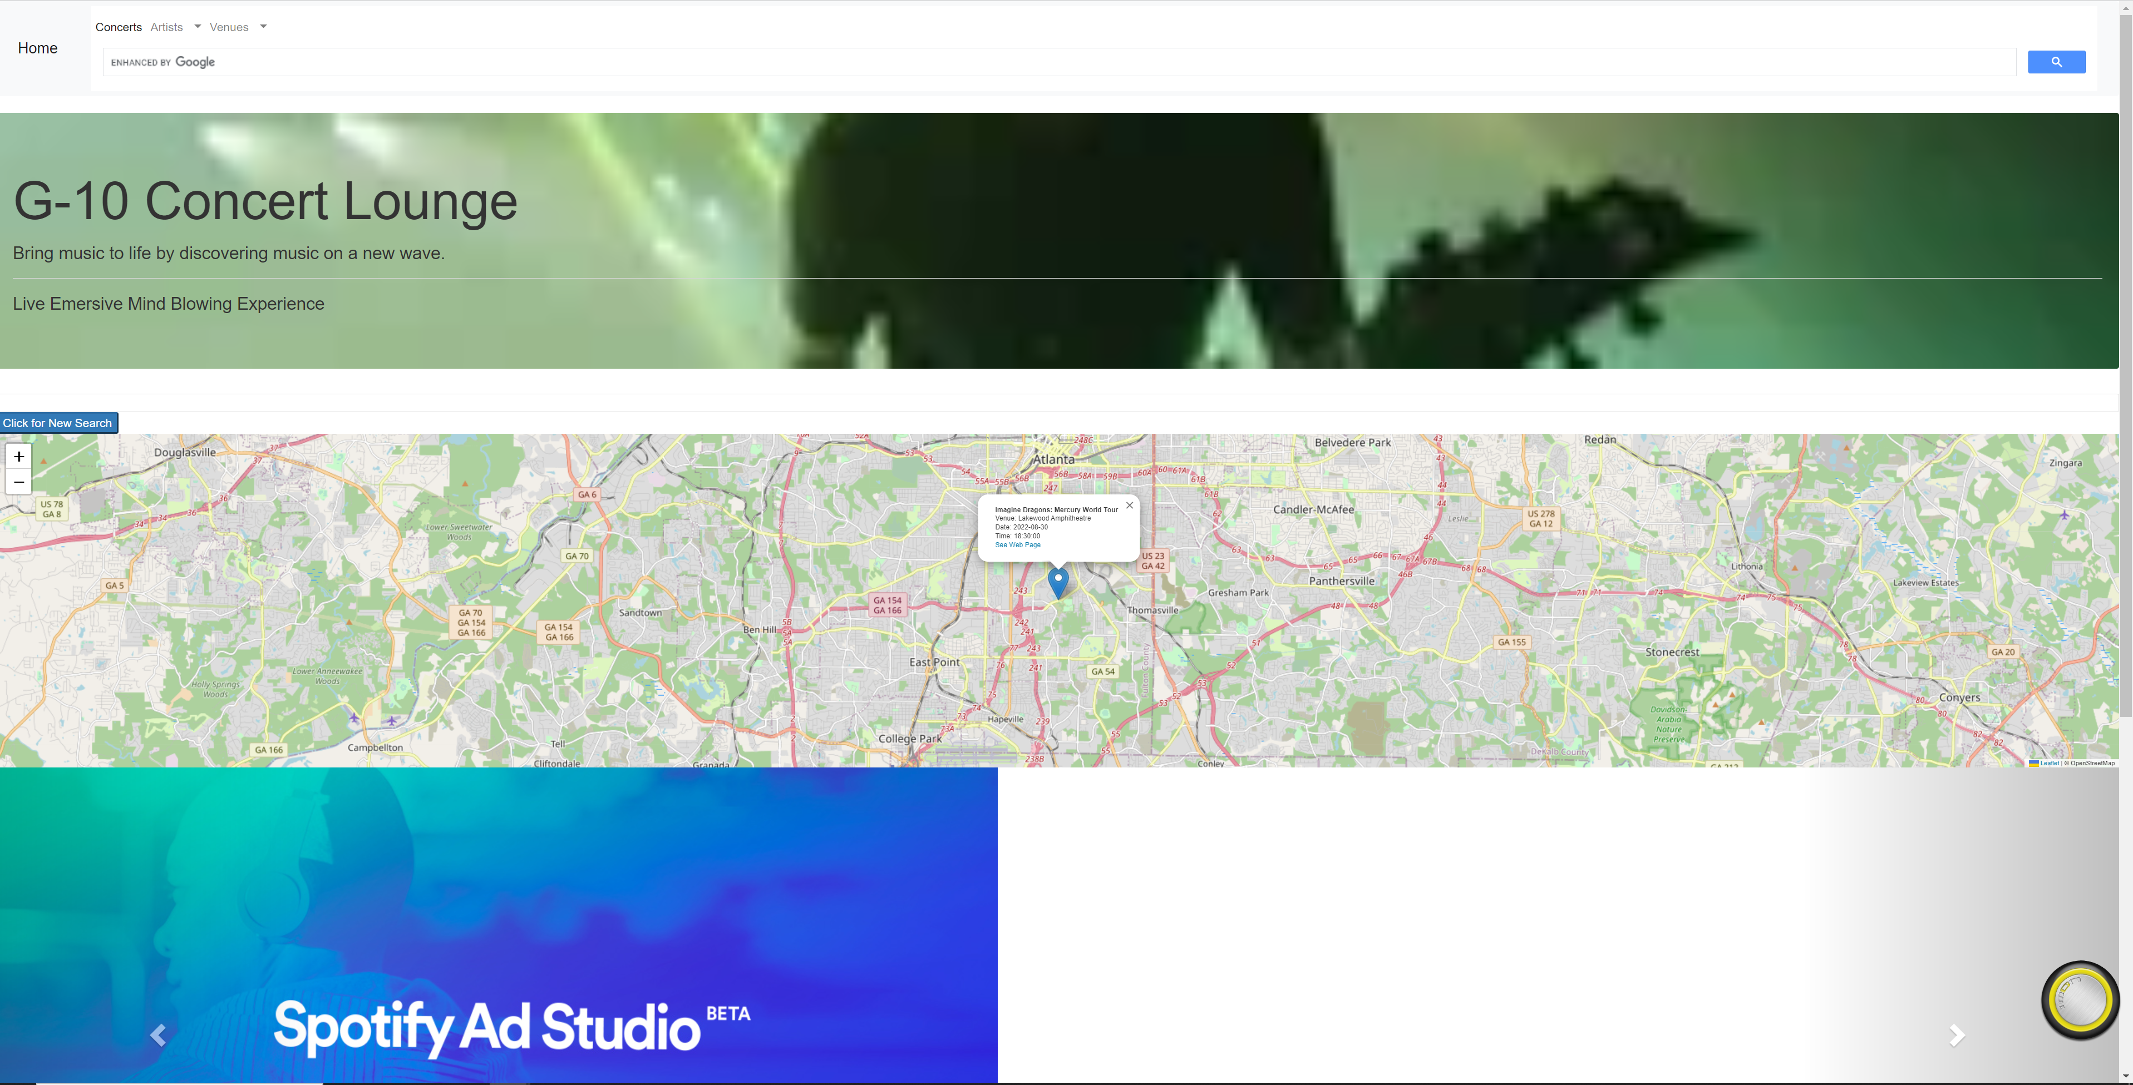
Website Screenshot

Slide 8
User Case Scenario
User
Scenario
Extremely Busy
Makes a lot of money
Programming
Consulting
Instructor
Doesn’t have a lot of time
Avid Gamer
Meets another person playing a game
Let’s say Lost Ark (it is a MULTI-PLAYER game after all..)
They find they live in the same area
The person invites our hypothetical user to a concert
The User says they’d love to go to the concert

Slide 9
User Case Scenario Cont…
The Problem
The Solution
Resolution
Our Hypothetical User only remembers the name of the band
He only knows about one band, Breaking Benjamins….
They don’t remember where the concert it located or when it’s occurring
They don’t even know any information about the band (songs, members etc..)
What will they do?????
The User goes to G-10’s Concert Lounge
They select their state and type in the band name
The receive options showing the location and time of the band’s performance
They use the search bar in the top right to look up the band’s information so now they are an expert.
They can even listen to some of the band’s tracks using the Pandora link in the Carousel
*Gasp* Disaster! The user needs to purchase two more tickets (for their parents) to the concert.
They use the carousel Ticketmaster link to buy more tickets
The user, friend and parents all go to the concert and have a great time!
The User impresses his friend with their knowledge about the band and their ability to sing along with the songs
The parents are thrilled because soon they may have grandbabies.

Slide 10
Future Additions
Release
V1.0 Initial Release – Would like to add directions
Adding Info Card
Info card displayed directly on page related to the Band
Music Player
Embedded Music Player on the pages that plays the music of the Band
State Concert Lookup
Tour Tracker
Users can input a band name and see entire concert tour paths and dates displayed on the map
Allows User to see list of concerts playing in their state. Displays times and locations on the map when selected

Slide 11

Summary
With G-10’s Concert Lounge you can easily find concerts in your area by band name. You can look up information about the band and listen to their music to ensure you’re up-to-date on all the latest news.

Slide 12


Thank You
G-10
https://github.com/MLyjak1/G-10_Musical_Chairs
https://mlyjak1.github.io/G-10_Musical_Chairs/#gsc.tab=0

